Slide 1






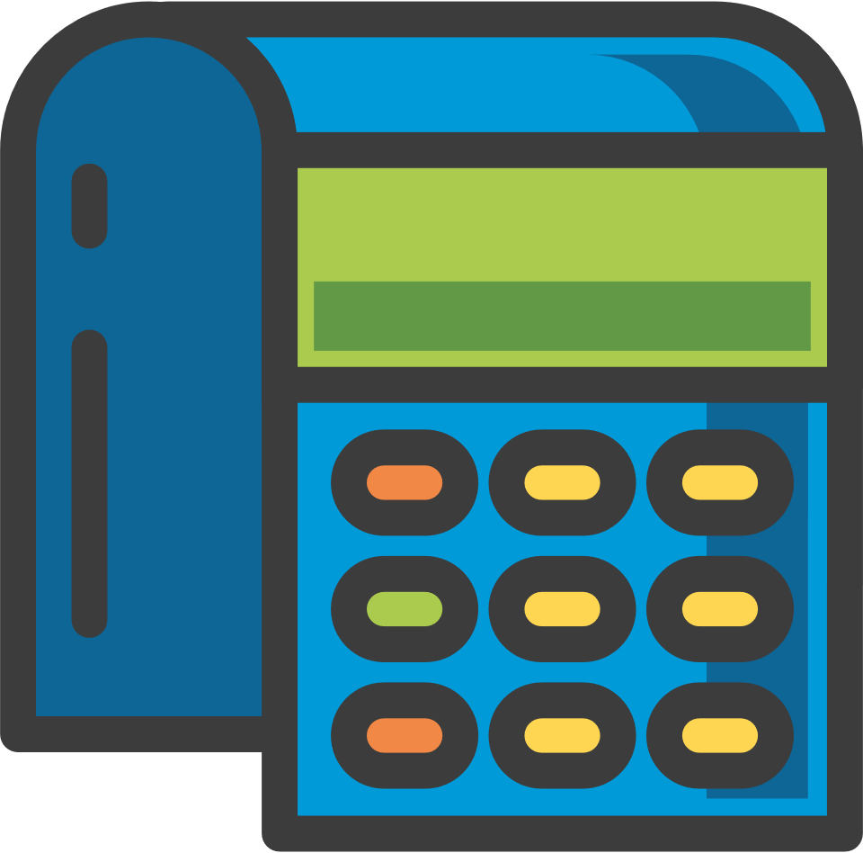

CREDIT CARD FRAUD
Created by Charlton D’Souza, Kira Voges and Raquel Banderia
14/12/2023

Slide 2

Introduction
01
Our Dataset
02
Data Pipeline
03
Data Cleaning
04
Table of Contents
Normalisation
05
SQL Database
06
Python Analysis
07
PowerBI Analysis
08
This is the material point that will be delivered in the presentation.
Excel Dashboard
09
Roadblocks
10
Recommendations
11
Future Developments
12

Slide 3


Our focus includes analysing the prevalence of fraud in the dataset, understanding the distribution of fraudulent transactions over time and profile the merchants and customers.
Introduction
Group Project :
Tools to be used:
This Group Project will analyze credit card fraud data, utilizing the skills we have learnt during the program.
Python
SQL
EXCEL
POWERBI
Our Steps :
End users :
Data Transforming
Exploratory Data Analysis
Visualization and Reporting
Our Analysis will benefit towards Financial Institutions, Law Enforcement Agencies and Credit Card Companies

Slide 4



Our Dataset
We extracted our Dataset from Kaggle.com
Consists of 23 Columns x 555719 rows
It pertains a record of legitimate and fraudulent transactions within USA
The Period in which these transaction takes place is between June 2020- December 2020

Slide 5
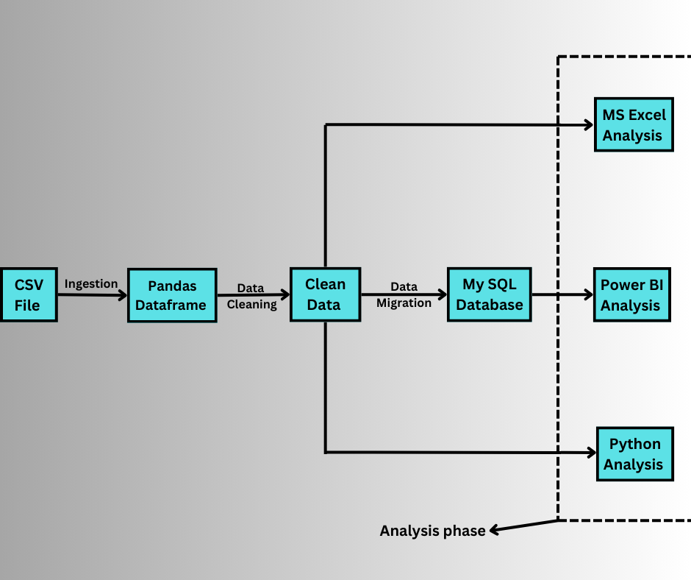


Data Pipeline

Slide 6

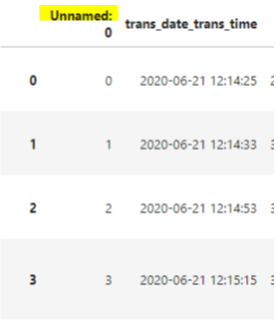
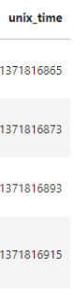
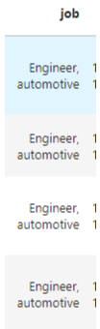
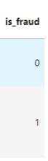
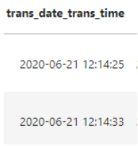
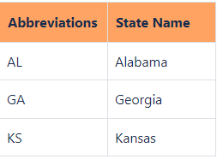


Data Cleaning on Python
Original Dataset
Data Cleaning continued…

Slide 7
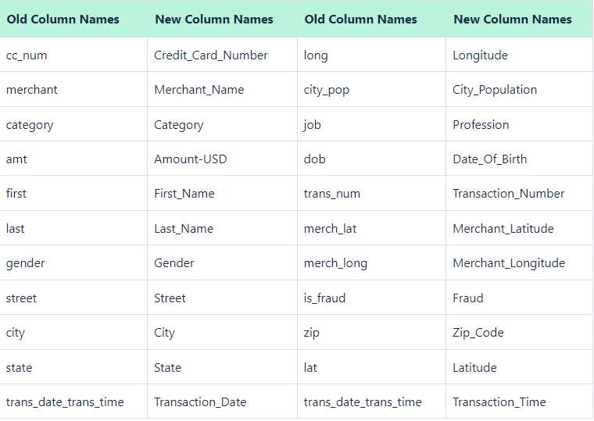
Data Cleaning
Redefined Columns

Slide 8
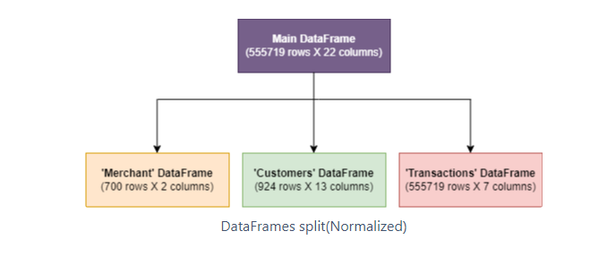

Normalisation
Utilising Pandas, we split the clean data frame into 3 data frames each describing attributes associated to Merchants, Customers and Transactions.

Slide 9
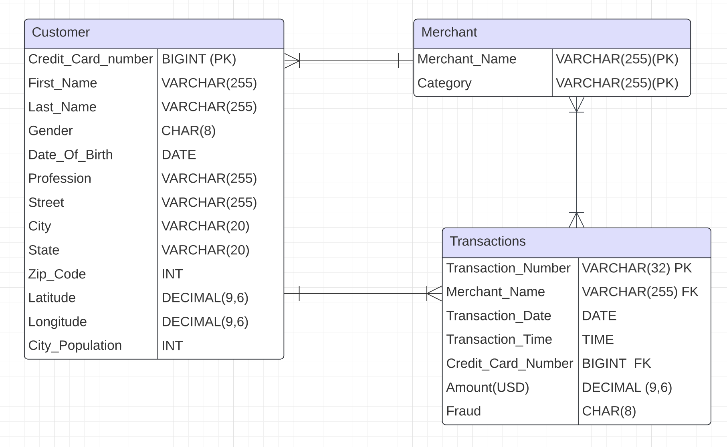
SQL- ER Diagram

Slide 10

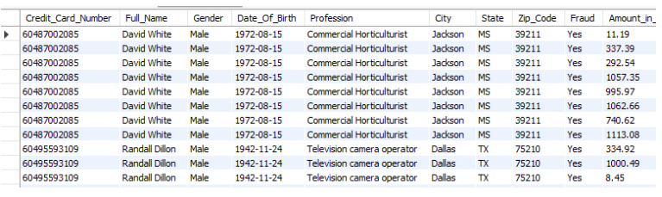
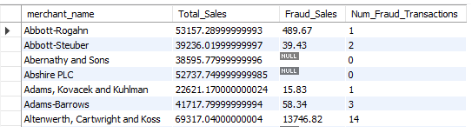
SQL-Auxiliary Tables
Created Auxiliary Tables to ensure quick look-ups
Provides a good summary focusing on Merchants and Customers
Created ‘fraud_customers’ table which contains all the details of the Fraudulent Customers
Created ‘merchant_details’ table pertaining to the merchants details, particularly the total fraudulent transaction amount and the number of frauds committed

Slide 11
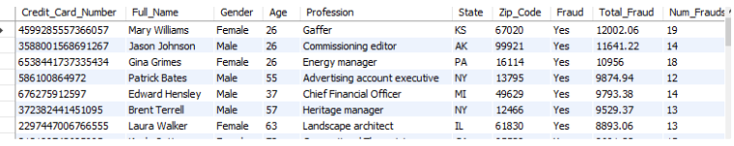
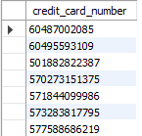
SQL-Views
Created Views to further summarise one of the auxiliary tables
Used Views to ascertain, we had
706 Customers who never did fraudulent transactions
202 Customers who did fraudulent as well as non-fraudulent transactions
16 Customers who only did fraudulent transactions
Created ‘fraud_customers_summary’ view to group by and summarise the ‘fraud_customers’ table
Created ‘fraud_n_nofraud_cust’ view to check who are the customers who are involved in fraudulent as well as non-fraudulent transactions

Slide 12
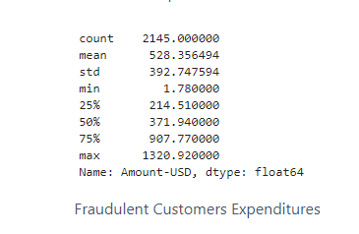
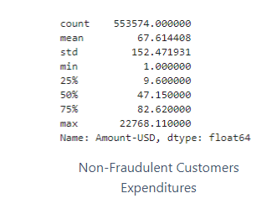
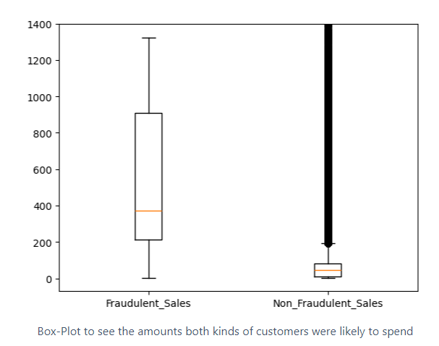
Python Analysis
Expenditure pattern for fraudulent and Non-Fraudulent Customers
Assumption:
Fraudulent Customers seem to be cautious in the amount they spend

Slide 13
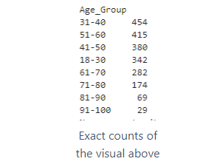
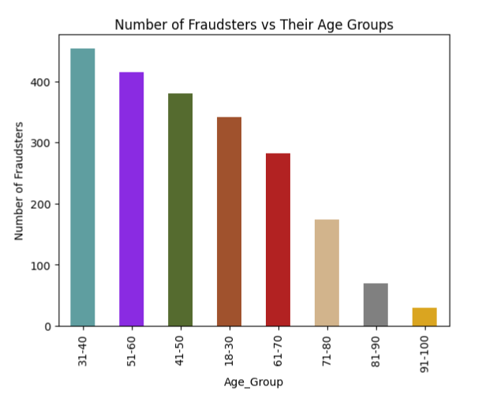
Python Analysis
Age-group analysis for Fraudulent Customers
More than 30% of Fraudulent Transactions were done by customers belonging to the age groups of ‘31-40’ and ‘51-60’

Slide 14




PowerBI Analysis
Credit Card Fraud - Power BI

Slide 15
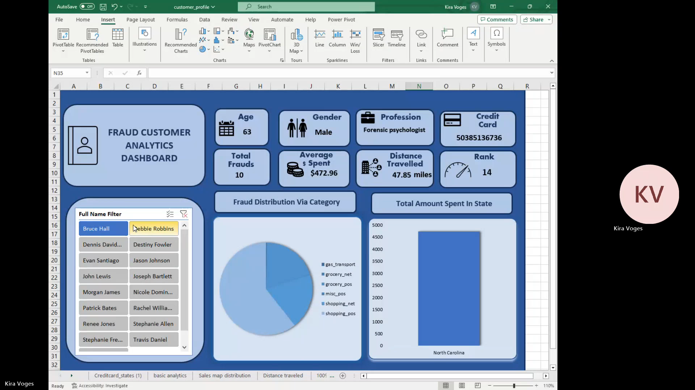
Excel Dashboard

Slide 16
Roadblocks
Python to SQL connection issues
Considered ‘sqlite3’ initially but went with ‘mysql-connector’.
MYSQL Workbench proved to communicate better with the database.
Offered a good interactive interface to run queries directly.
Exporting and importing the database into multiple systems is easy

Slide 17
Roadblocks
Loading a Dataframe onto MYSQL Server
Iterating through Dataframe errors
Used a list of tuples and ‘executemany’ command
MYSQL Server timeouts
Occurred when trying to load a massive Dataframe
Used ‘Iterators’ functionality in Python to load the rows batchwise

Slide 18
Roadblocks
Parted ways With Raquel
Redistributed tasks
Task Tracking and co-ordination
Tight knit collaboration
Navigating Data type Challenges
Changed the State Code into its full name on Python
This removed any ambiguity
Managing Large Dataset
Automatic saving process
Utilised Pivot tables for effective summarisation

Slide 19

Recommendations
Between the hours of 22:00- 04:00: enhanced multi-factor security authentication
Increase awareness of fraud for age groups of 31-40 and 51-60
Implementing additional verification steps for online shopping and grocery purchases, such as OTP, or app approval.
Merchants in States such as New York, Kansas, Connecticut, Alaska, and Idaho should implement better KYC processes

Slide 20
Future Developments
Cloud Migration of database instead of using an on-premise model
Create a classification model to predict Fraudulent Transaction
Create a live dashboard which interacts instantly on any data change
Acquire Data over the years to preform Time Series Forecasting

Slide 21




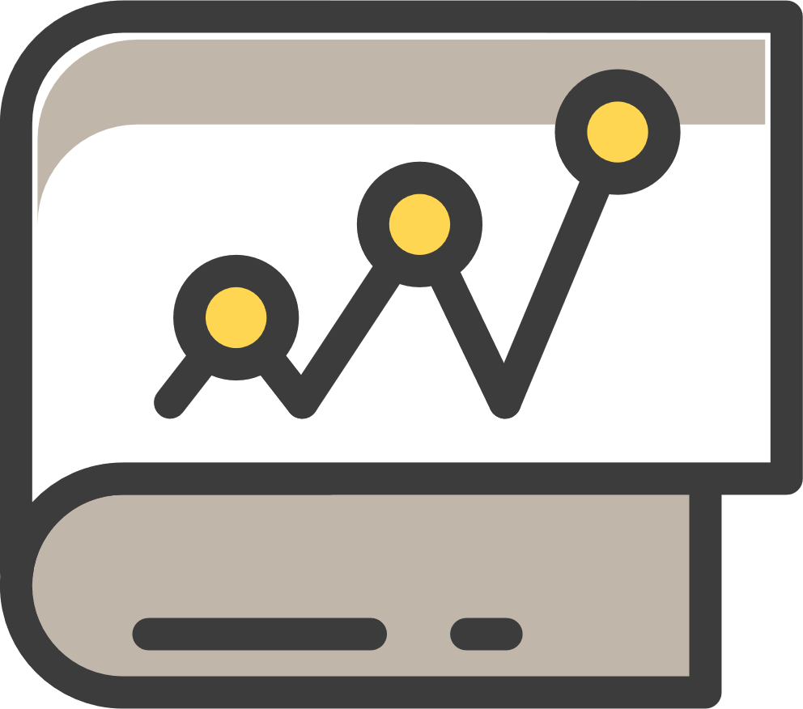
Thank You

